Slide 1
PLACED: LEADER IN LOCATION
500,000+
PLACED
Over 20 million
validated store visits to date, adding 20,000 PER DAY
double opt-in
PANELIST
panelists
20X LARGER
2
than industry
0 0 7 5 2 ₃
leading panels
OTHERS
0 Real world validation
Store counts validated by
THIRD OF THE TOP 12 RETAILERS
for TV and
mobile
PLACED
OTHERS
AVERAGE 1,000
accurate locations per day direct from the user
AVERAGE 5
accurate locations per user per day via 3rd and 4th parties
= 5 Third Party Locations
= 5 First Party Locations

Slide 2
PLACED: FIRST PARTY, OPT-IN, VERIFIED
PLACED
OTHERS
NO OPT-IN
No opt-out, privacy issues
PUSH
3rd party controlled, coarse location, only on when app is open
1st PARTY DATA
User directly installs an app on device
DOUBLE OPT-IN
Simple opt-out
PULL
GPS, Wi-Fi, Cellphone, Accelerometer, Compass, Gyroscope
DIRECT CONSUMER RELATIONSHIP
Demographics
YES Validation
Surveys
Demographics Validation Surveys
NO

Slide 3
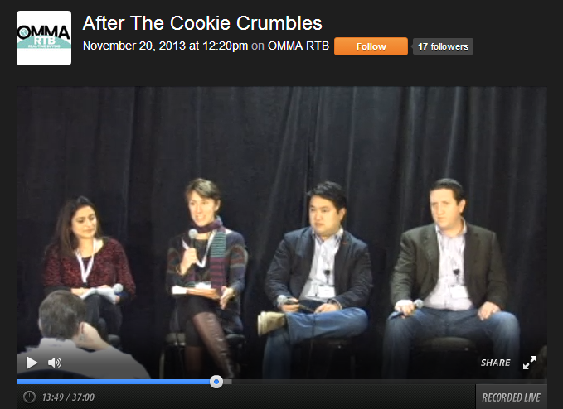
PLACED: PRIVACY FIRST
“I think this is great that you are doing this with an opt-in model, and a very transparent one…getting better data and avoiding regulatory problems.”
Julie Mayer, Staff Attorney, FTC
https://www.youtube.com/watch?v=gTXHUynVJos

Slide 4
PLACED: PERSISTENT MEASUREMENT
5:30
5:32
5:34
5:36
5:38
5:40
5:42
5:44
5:46
5:48
5:50
5:52
6:00
5:54
5:56
Continuous measurement of location
Precise location attribution

Slide 5
PLACED: VALIDATION
THE ONLY ATTRIBUTION SOLUTION THAT VALIDATES ITS MODELS
VALIDATED
VALIDATED
Question 1 of 1
Where were you Tuesday at 2 p.m.?
Starbucks Target McDonald’s Walgreens
Placed programmatically samples its panel to train and validate its models
VALIDATED
20,000,000+
VALIDATIONS TO DATE
Submit
PLACED
0
VALIDATIONS TO DATE
OTHERS

Slide 6
PLACED: BEST IN CLASS REPORTING
AD EXPOSURE
VISITS
LIFT
AD
LIFT
•Industry Standard for Ad to In-Store
•Common Currency Across 50+ Partners
•No Tags Required
•Reporting via Web UI
•Number of Store Visits
•Store Conversion Rate
•Cost Per Store Visit
•Percentage Lift
•Number of Lift Store Visits
•Exposed vs. Unexposed Store Conversion Rate
•Cost Per Lift Store Visit
AUDIENCE FEATURES –
EXPOSED, EXPOSED + STORE VISIT:
9 OUT OF 10 DIGITAL AD CONVERSIONS OCCUR OFFLINE
Demographics Geography
Businesses Visited Apps Installed

Slide 7
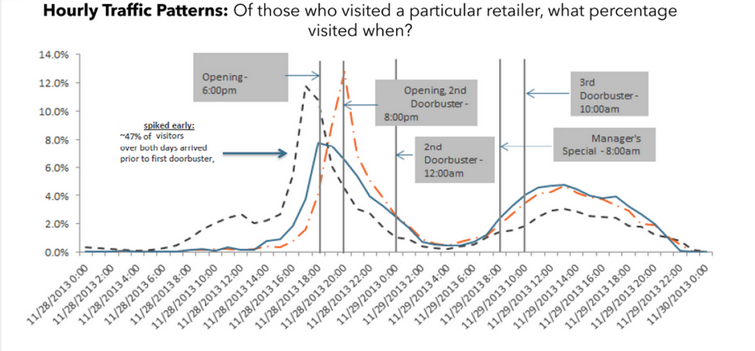
PLACED: BLACK FRIDAY

Slide 8
WASHINGTON: HOME OF THE CLOUD

Slide 9
WASHINGTON: GEO EXPERTISE

Slide 10
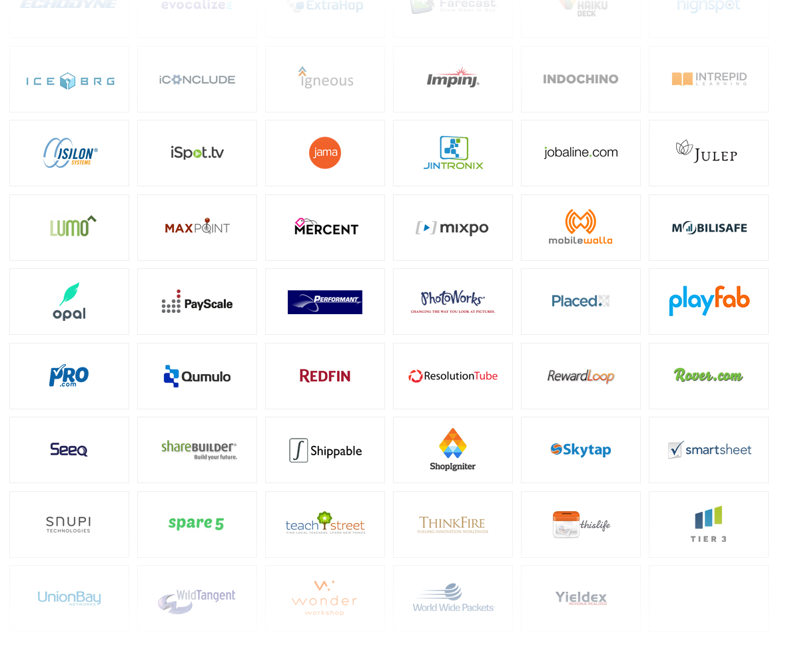
WASHINGTON: PRACTICAL STARTUPS

