Slide 1
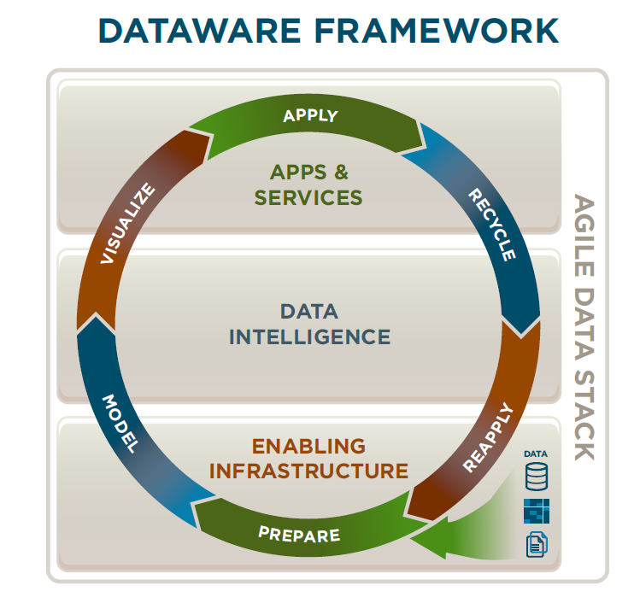
Madrona Dataware Framework
Marc Benihoff, Founder and CEO of Salesforce.com, when asked what he thinks is the major tech trend of the next five years responded that we are in an “AI Spring.” Fortune Term Sheet 1/6/15

Slide 2
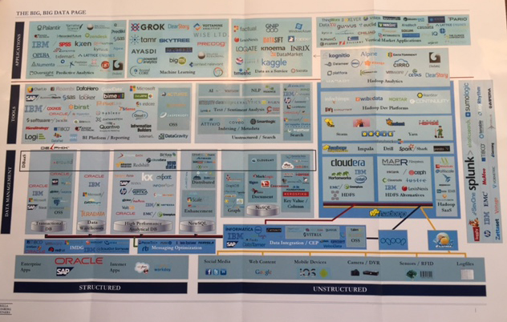
The Big, Big Data Page

Slide 3
Madrona Dataware Investments
BIZIBLE
HIGHSPOT
APPS & SERVICES
CONTEXT RELEVANT
JOBALINE
YIELDEX
BOOMERANG
SEEQ
PLACED
MAXPOINT
APPTIO
GRAPHLAB (DATO)
EXTRAHOP
DATA INTELLIGENCE
AGILE DATA STACK
ALGORITHMIA
ICEBRG
QUMULO
ENABLING INFRASTRUCTURE
IGNEOUS
Fund III Fund IV Fund V

